Slide 1

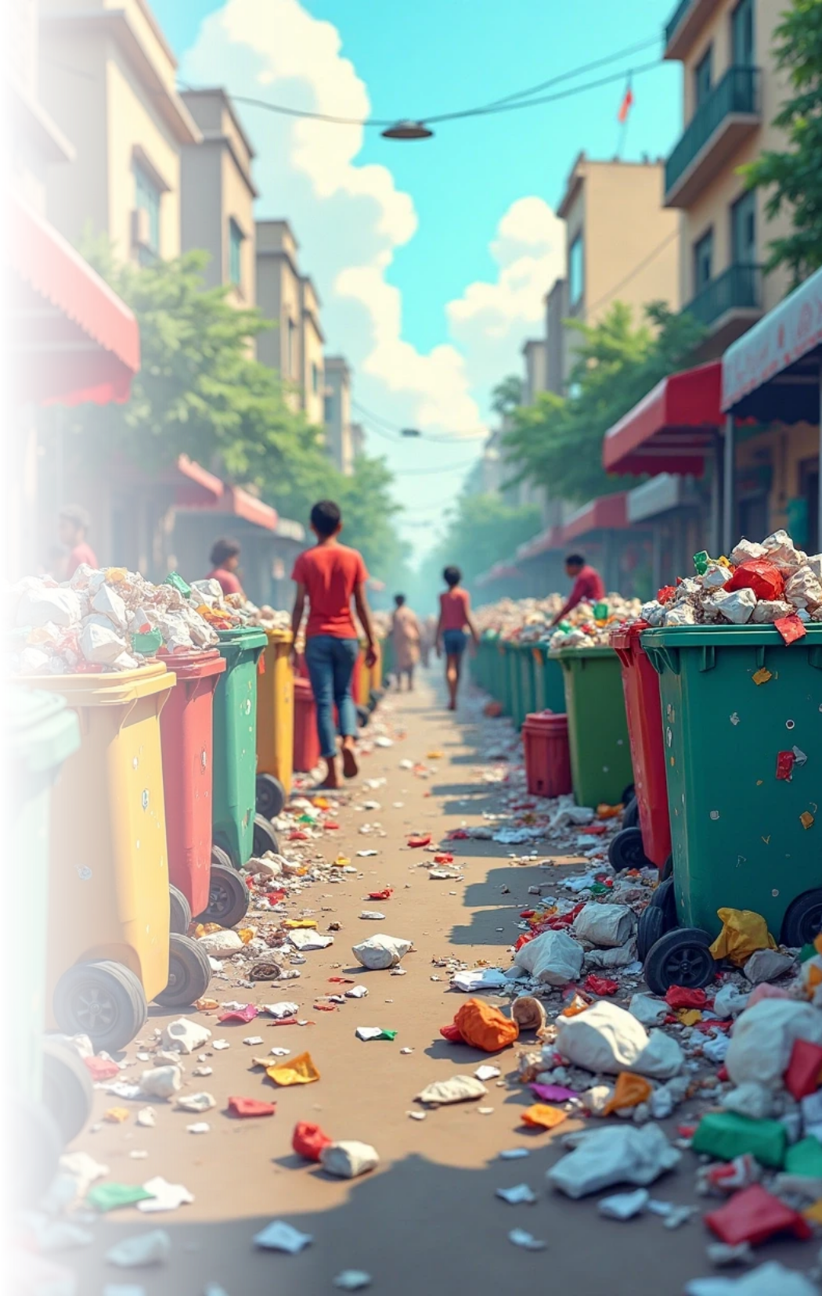
Garbage Problem in India
India's garbage problem is an escalating environmental crisis impacting urban areas, public health. As cities grow, so do the challenges of waste management. Effective solutions, including innovative technologies and artificial intelligence, are essential to address this pressing issue. Collaborative efforts and sustainable practices will play a critical role in transforming waste management in India.

Slide 2


Waste Management Challenges in Urban Areas
Urban Overpopulation
Inadequate Waste Management
Improper Segregation
Rapid urbanization in cities leads to increased waste generation.
A lack of awareness leads to improper waste segregation.
Many cities lack efficient waste collection and disposal systems.

Slide 3



Consequences of Garbage Accumulation
Environmental Degradation
2
Garbage pollution leads to soil and water contamination, affecting ecosystems and biodiversity.
Health Hazards
Piled-up garbage poses health risks, attracting disease-carrying pests and increasing the risk of diseases such as dengue and cholera.
1
Economic Impact
The mishandling of waste creates significant economic costs, including public health expenditures and loss of tourism due to polluted environments.
3

Slide 4




Proposed Solutions for Effective Waste Management
1
Improved Waste Management Systems
2
Public Awareness Campaigns
3
Incentives for Recycling
Provide incentives for industries and communities to engage in recycling efforts.
Enhance collection efficiency and disposal methods through technology and planning.
Educate citizens about waste segregation, recycling, and responsible disposal.

Slide 5
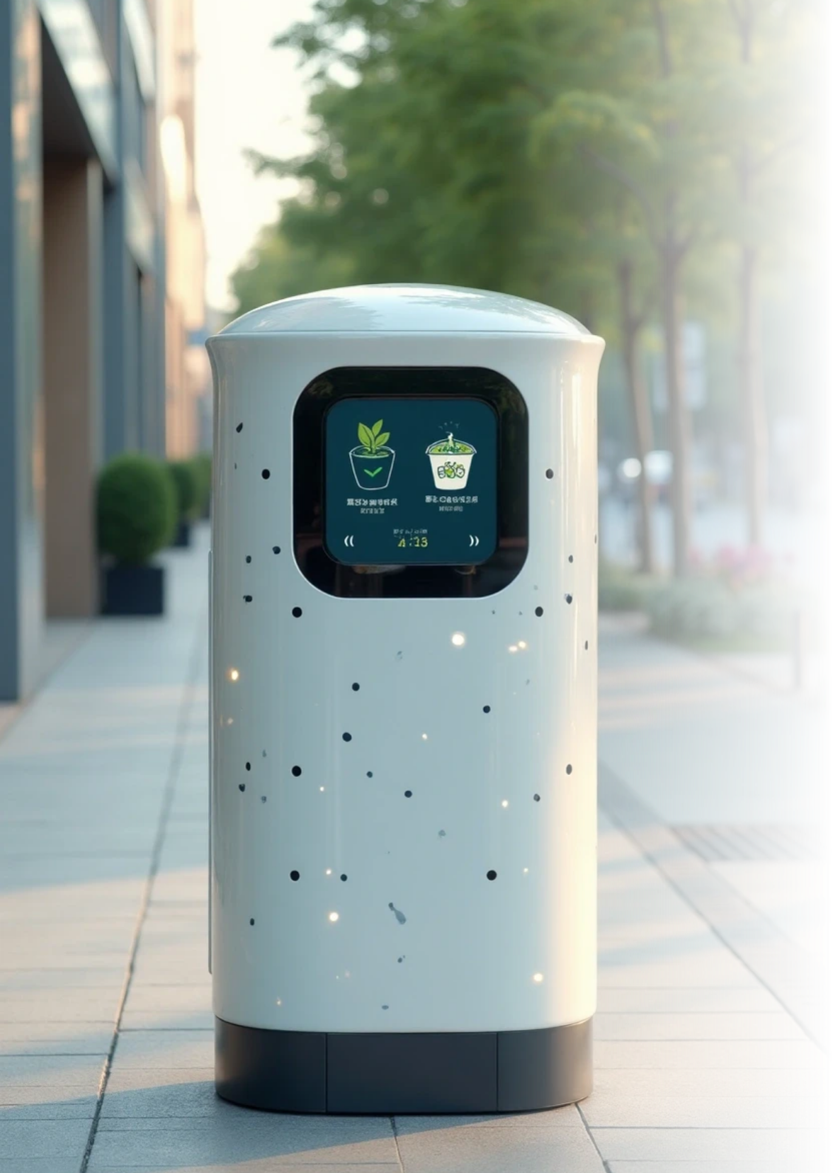


Role of AI in Solutions
Data Analysis for Waste Prediction
AI can analyze vast amounts of data to predict waste generation trends, helping municipalities allocate resources more effectively.
Smart Bin Technology
AI-enabled smart bins can optimize waste collection routes, ensuring timely pickups and reducing operational costs.
Automated Sorting Systems
AI can improve segregation processes in recycling facilities, increasing the efficiency of sorting recyclable materials from non-recyclables.

Slide 6

Statistics Supporting the Waste Management Crisis in India
30%
600 million
$14 billion
Waste Processing Efficiency
Urban Population Growth
Annual Health Costs
Only about 30% of the 62 million tons of municipal solid waste is processed efficiently.
An increase of over 600 million people in urban areas is expected by 2030.
Improper waste management costs the Indian economy around $14 billion annually in public health impacts.

Slide 7

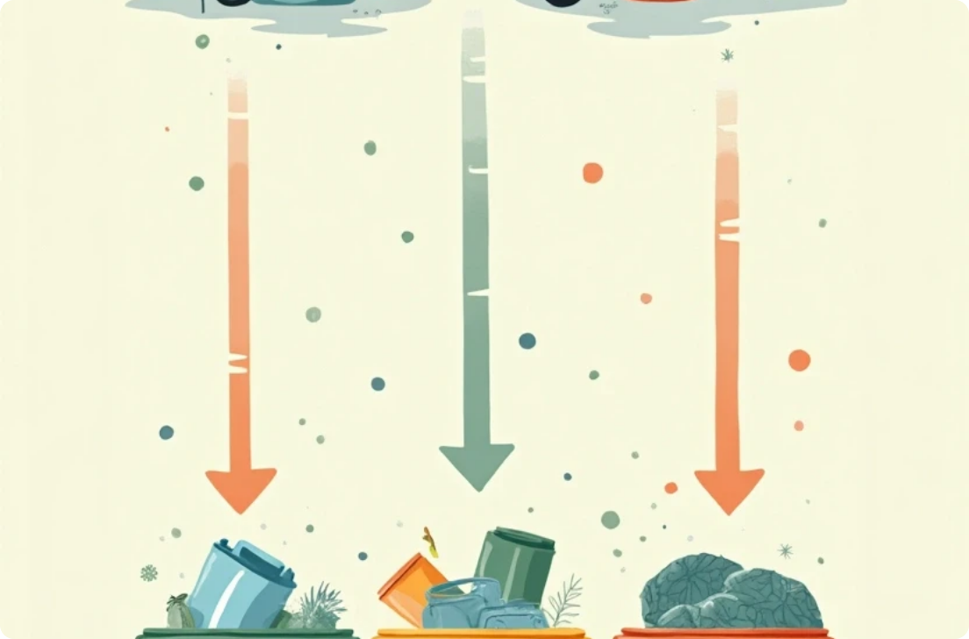
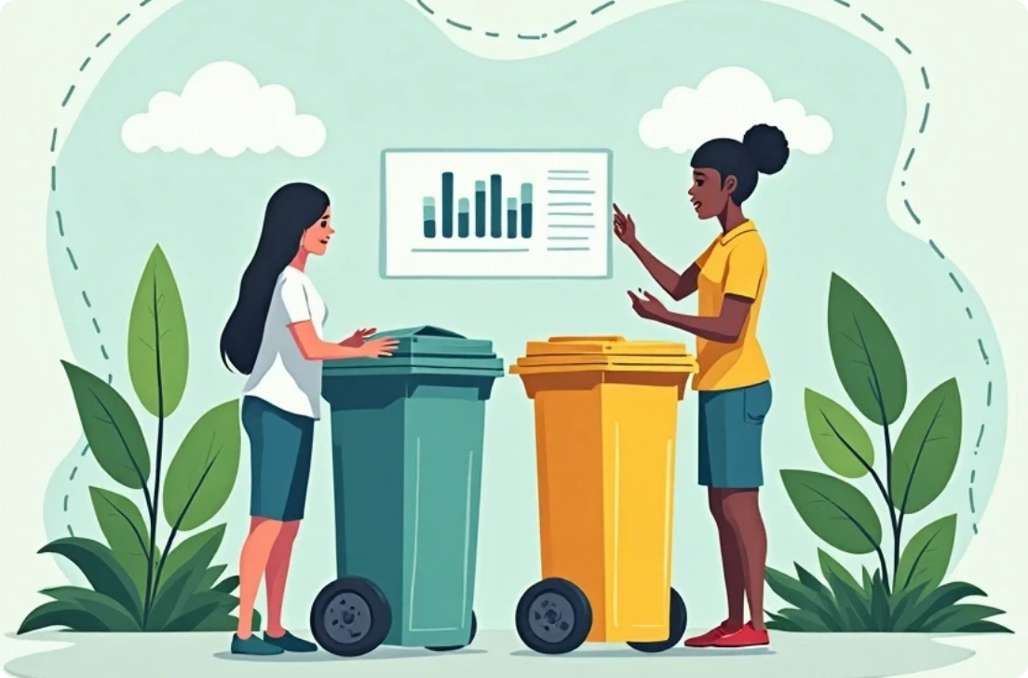
Successful Case Studies
Swachh Bharat Mission
Bangalore's Waste Segregation Model
AI Initiatives in Chennai
The government initiative has significantly improved sanitation and waste management practices in many cities, showcasing the potential for widespread change.
Chennai's use of AI for predictive waste management has improved collection efficiency and reduced operational costs significantly.
Bangalore's model encourages citizen participation and effective waste segregation, leading to higher recycling rates and reduced landfill reliance.

Slide 8
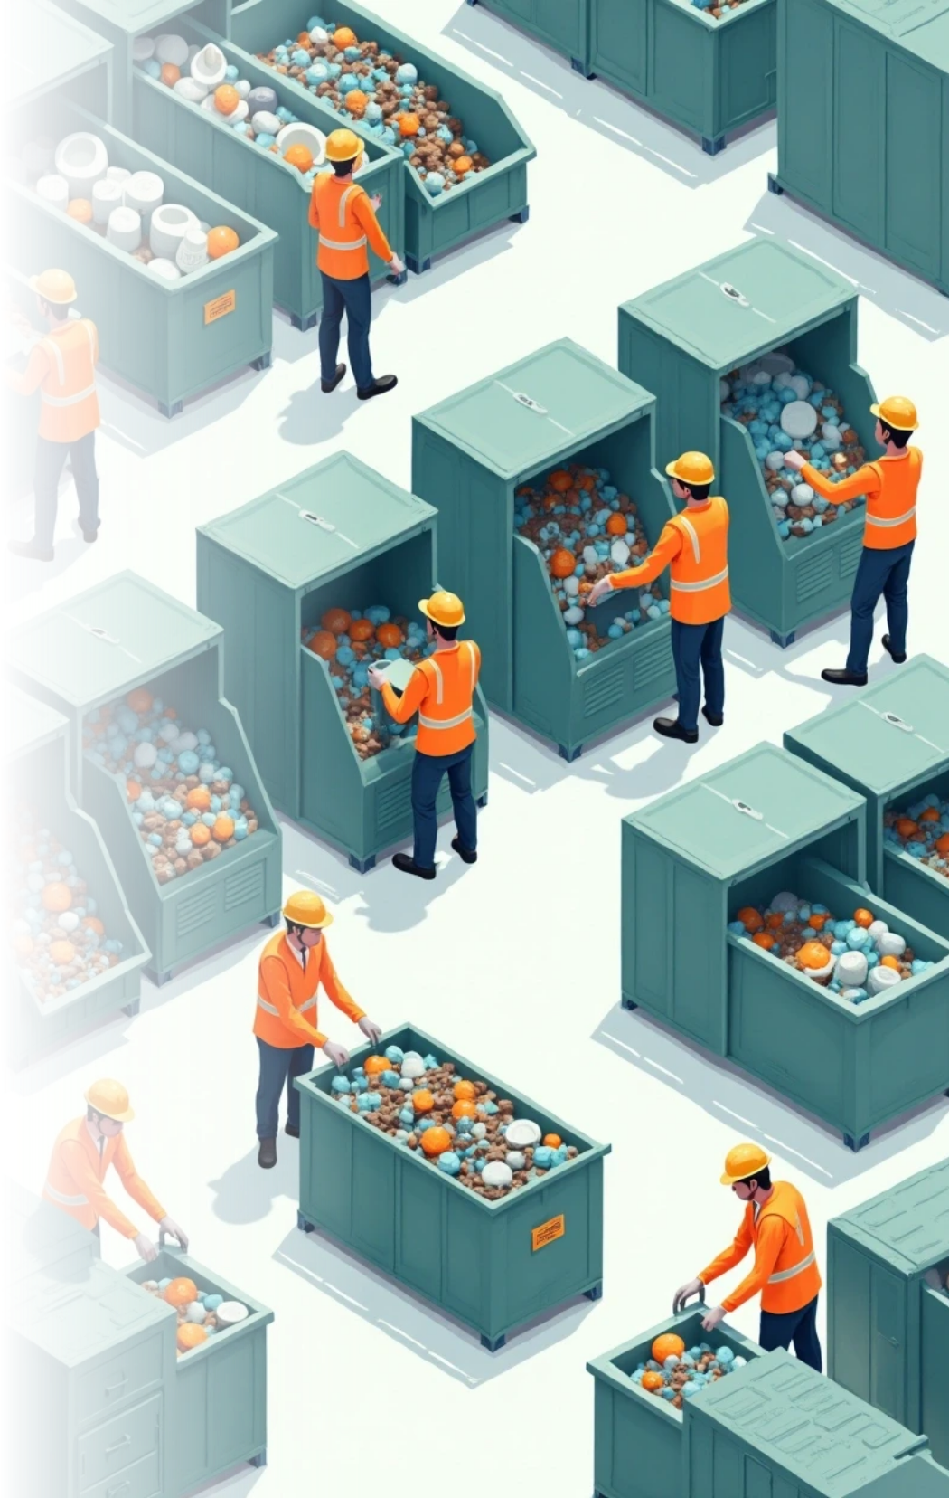

Addressing India's Garbage Problem
Multifaceted Approach
Combining waste management strategies.
Public Awareness
Increasing community engagement in waste management.
Technological Innovations
Utilizing AI and tech solutions in managing waste.

Slide 9




















